Slide 1
Analytical Report
Title: | TEM/STEM/EDS Analysis
Author: | Gayan Karunasinghe
Project #: | LF501RD0001
Requestor: | Kelvin Oliver
Executive Summary/Abstract: The sample was prepared using Drop Casting method (please check the Methods and Parameters in the slide number 2) The average particle size of the samples 1) 2-123417: 7.3±3.9 nm 2) 2-123418: 4.8±1.3 nm

Slide 2
Background
Project Name: LF501RD0001
Sample Number: 1) 2-123417
2) 2-123418
Motivation: Determine the particle size distribution of the catalyst sample.
Methods and Parameters: The sample was prepared using the Drop Casting method. The small amount of catalyst powder (~10 mg) was dissolved in a 100 % ethanol (~5 ml) and sonicated for 15 minutes. Then, a drop of the solution was put on a copper coated lacey carbon grid and dried the sample. TEM/STEM/EDS was performed on FEI Talos F200X at the University of Kentucky.

Slide 3
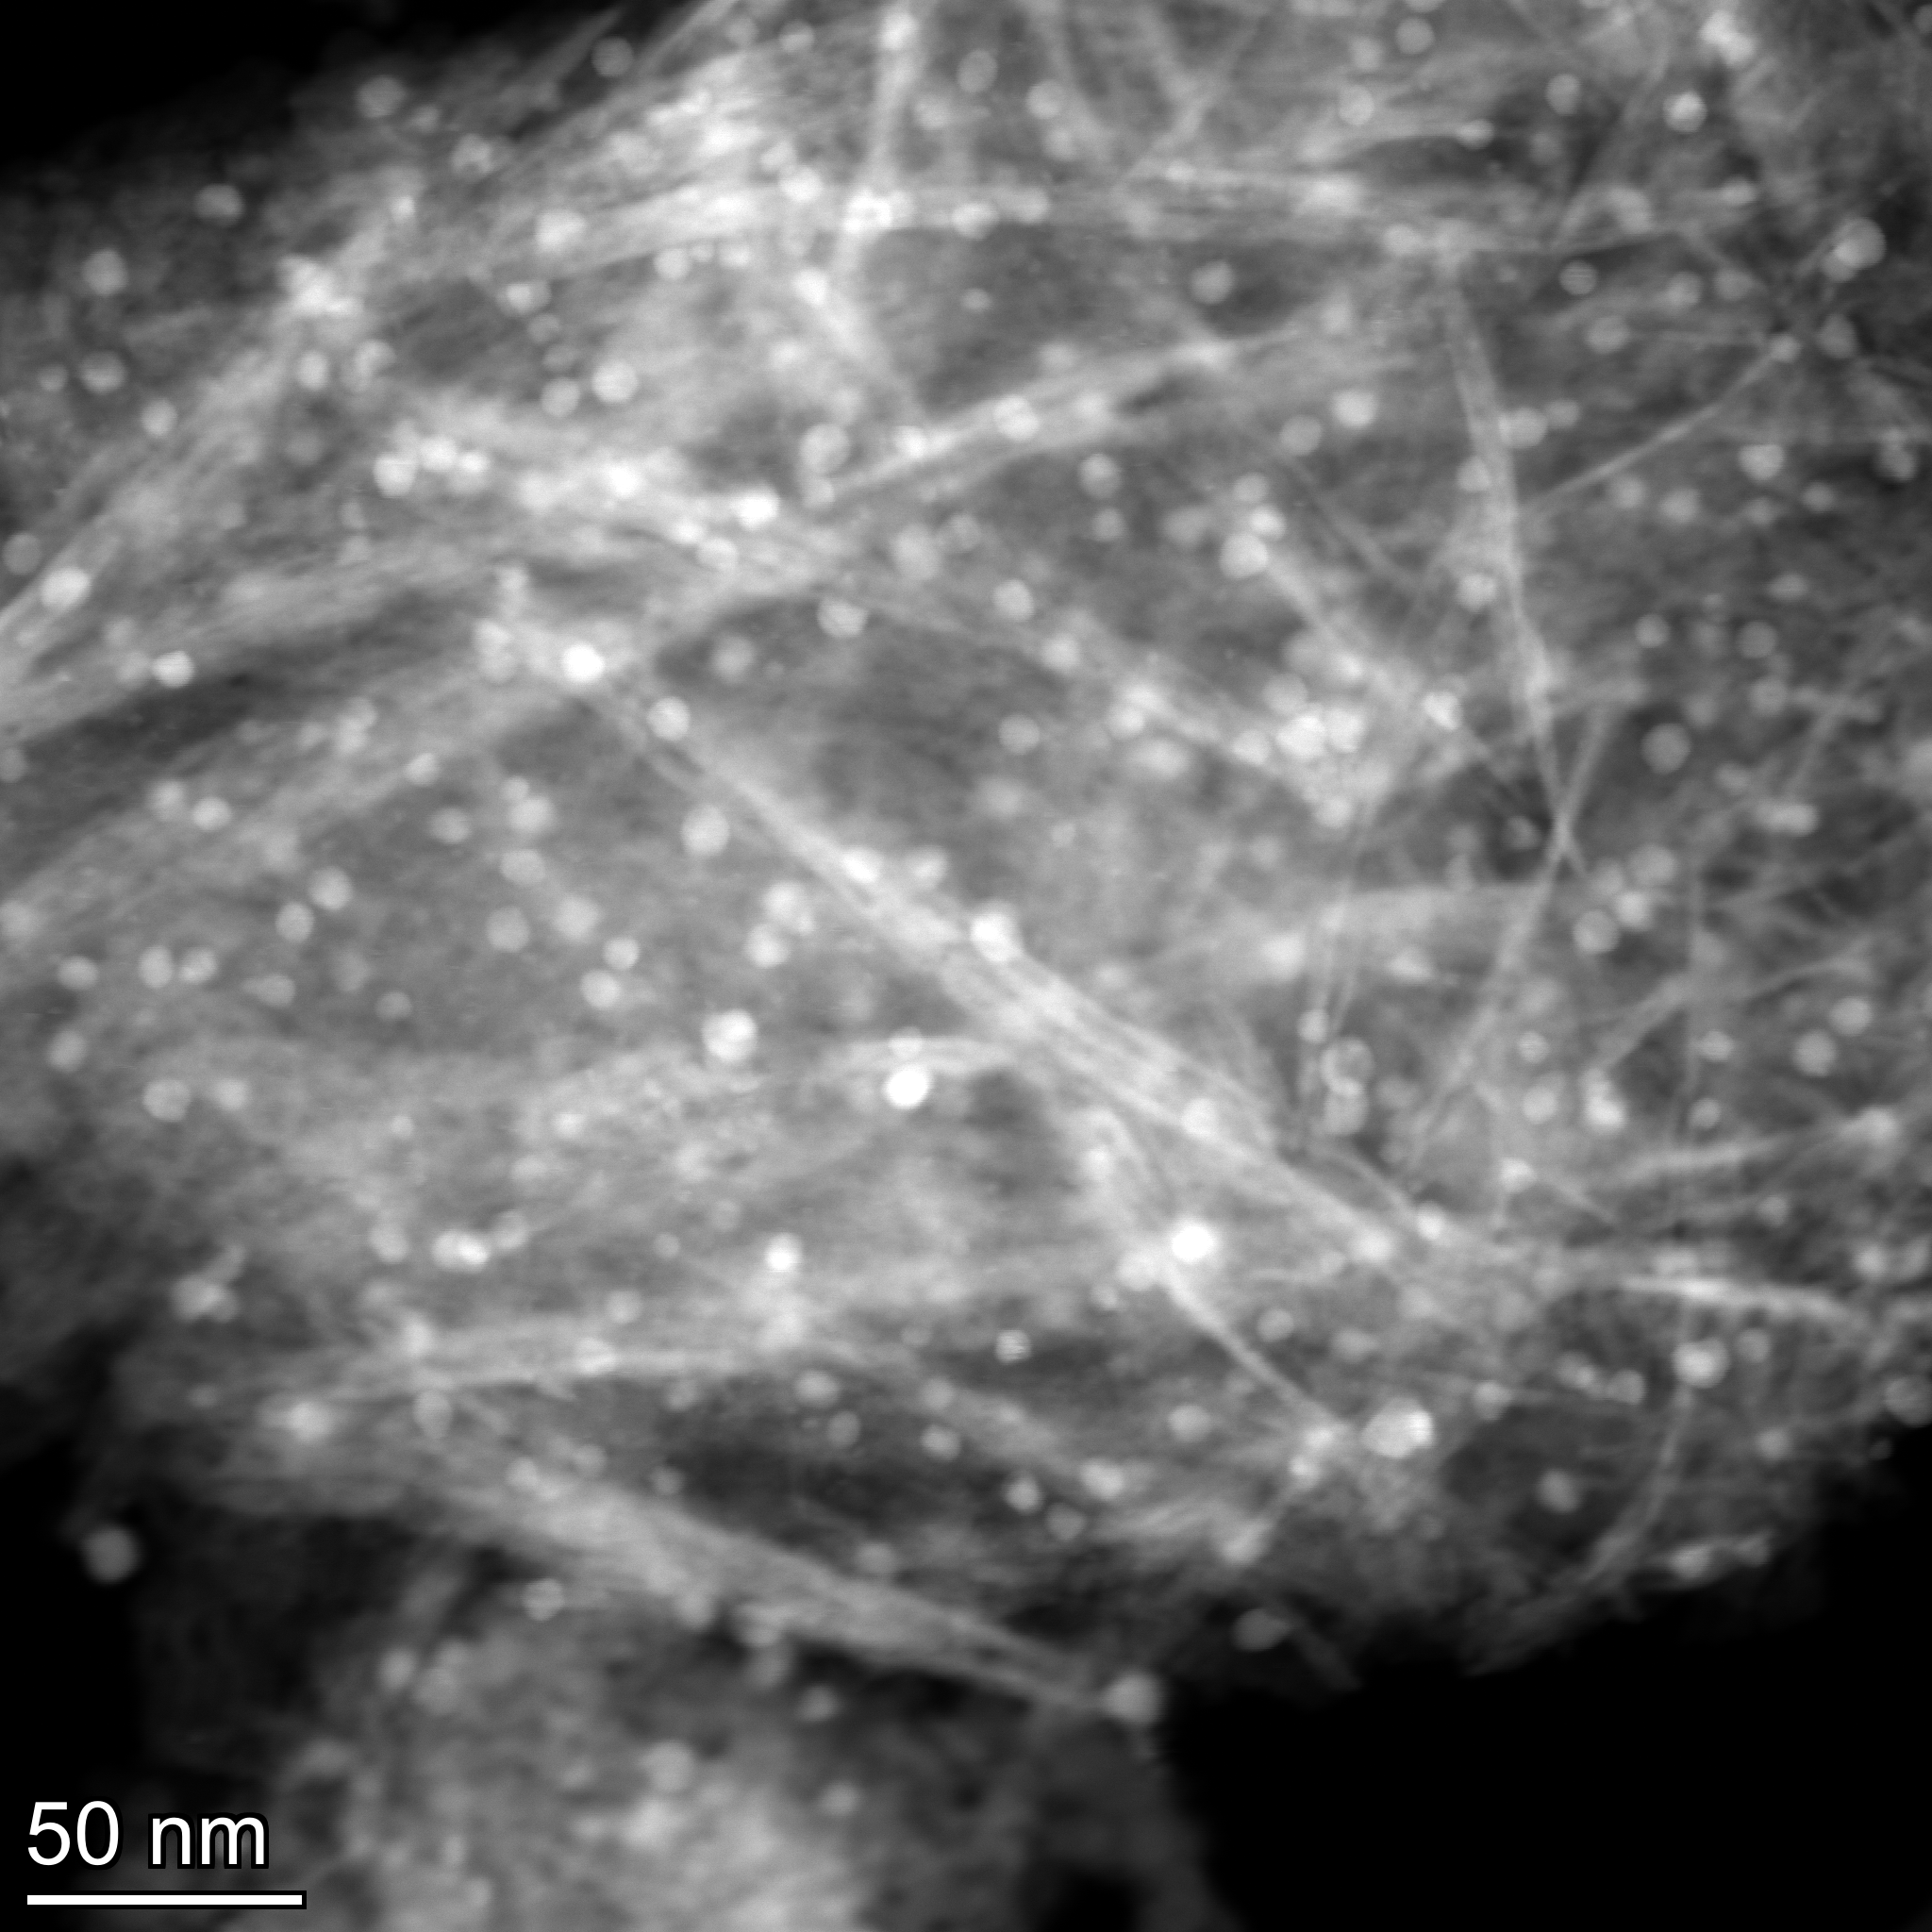
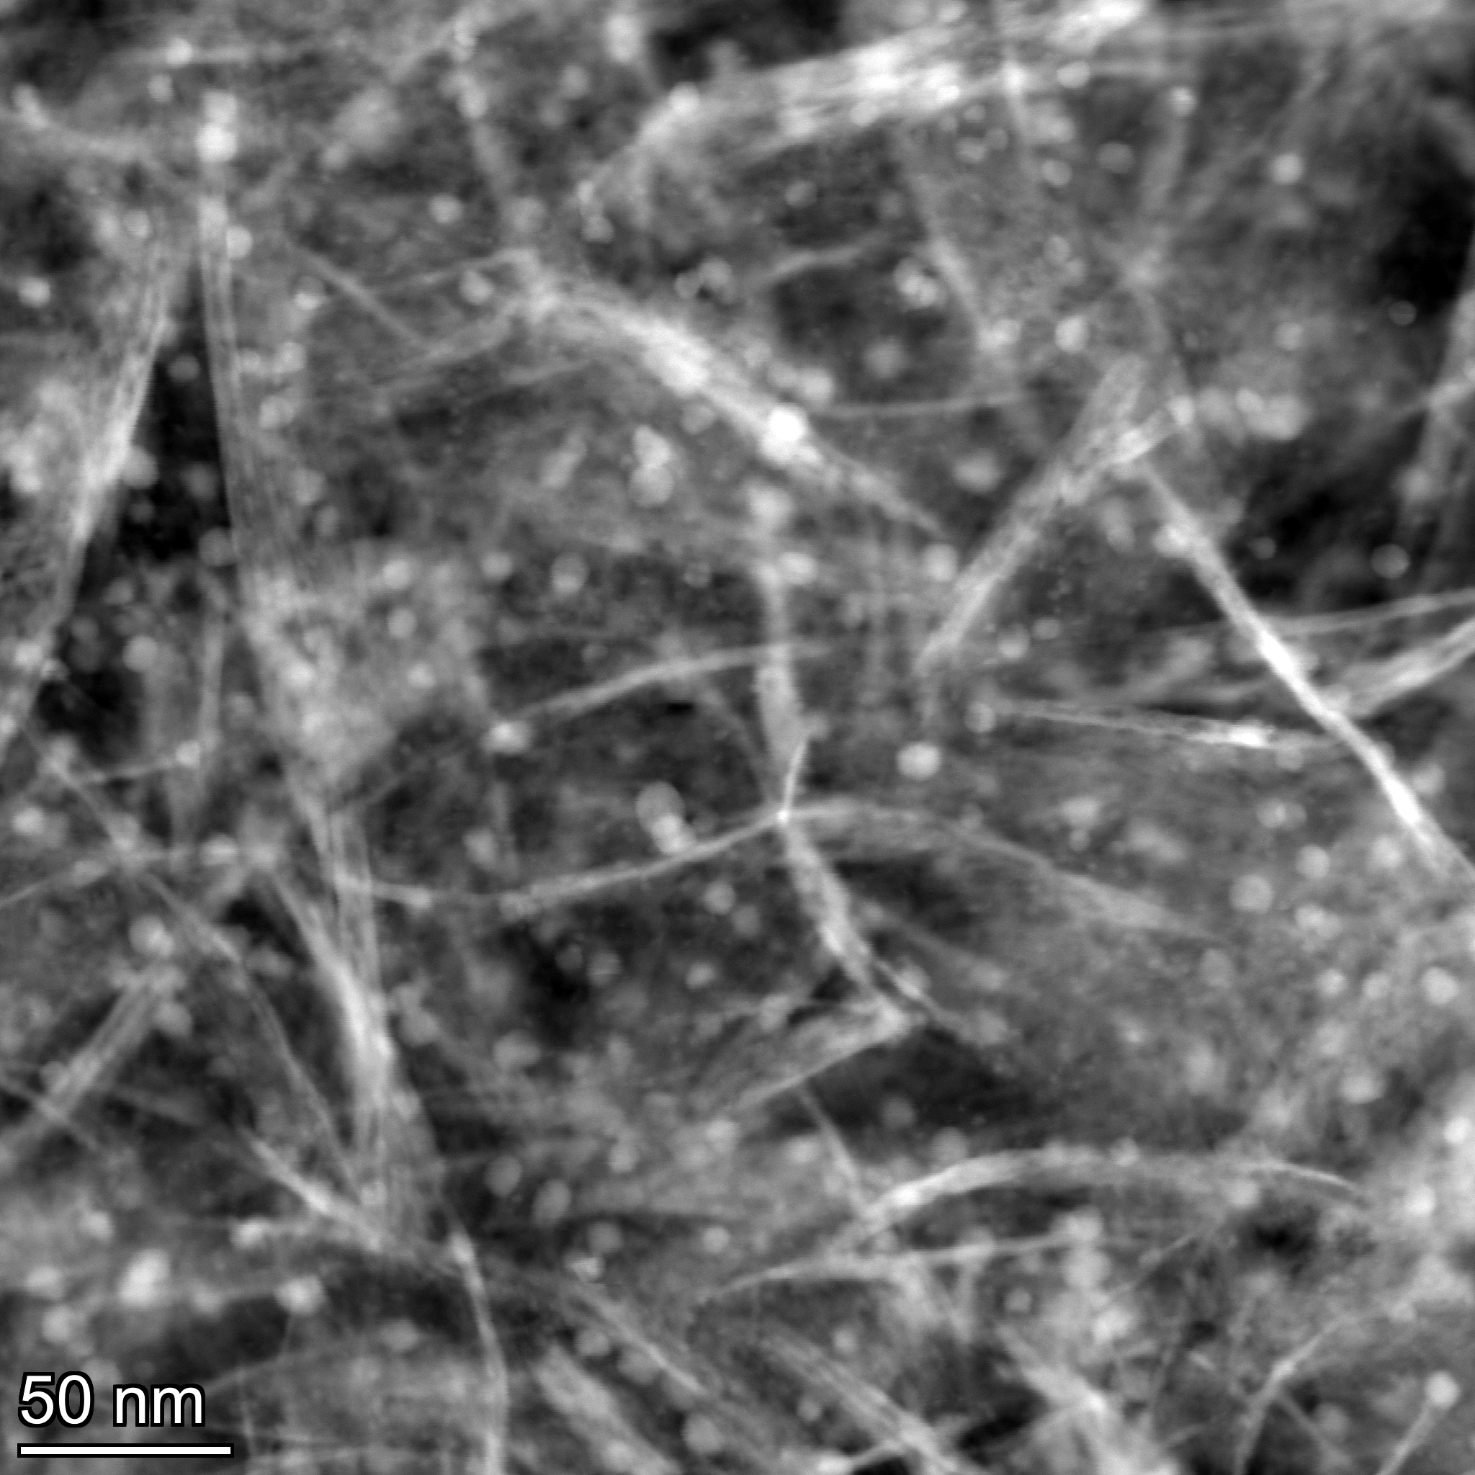
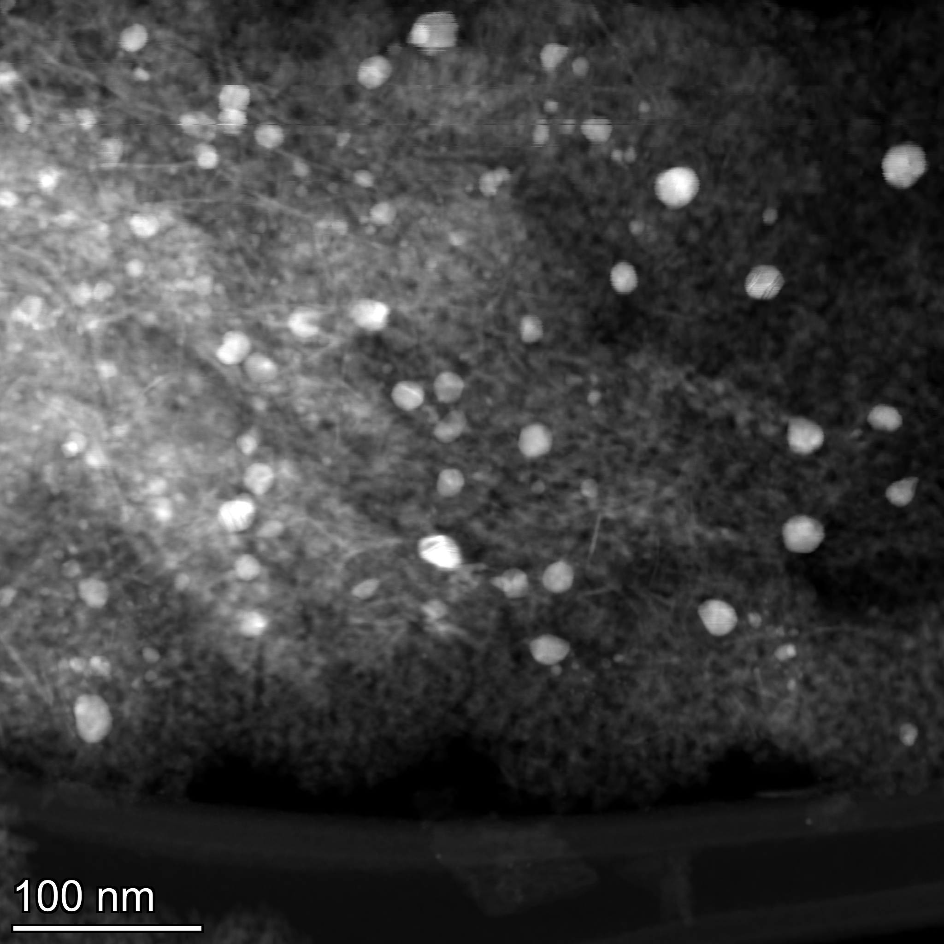
STEM images for : 2-123417
The bright spots are Ag particles (HAADF was used, so heavier elements appear bright) and EDS was used to ensure nothing else was present

Slide 4
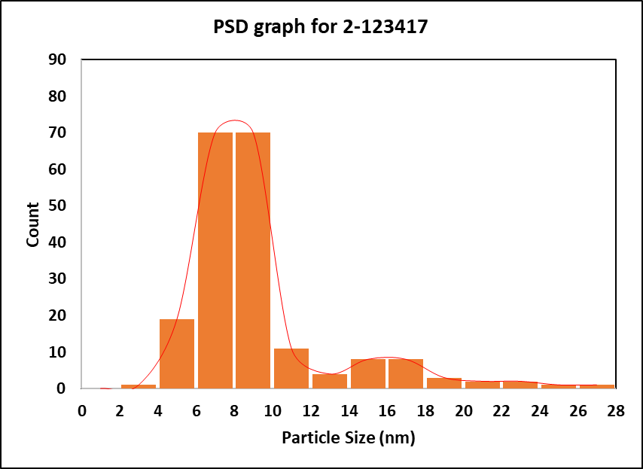
Particle Size Distribution (PSD) Graph for : 2-123417
Average Particle size: 7.3±3.9 nm
A total of 200 particles were analyzed to determine the average particle size of the catalyst

Slide 5
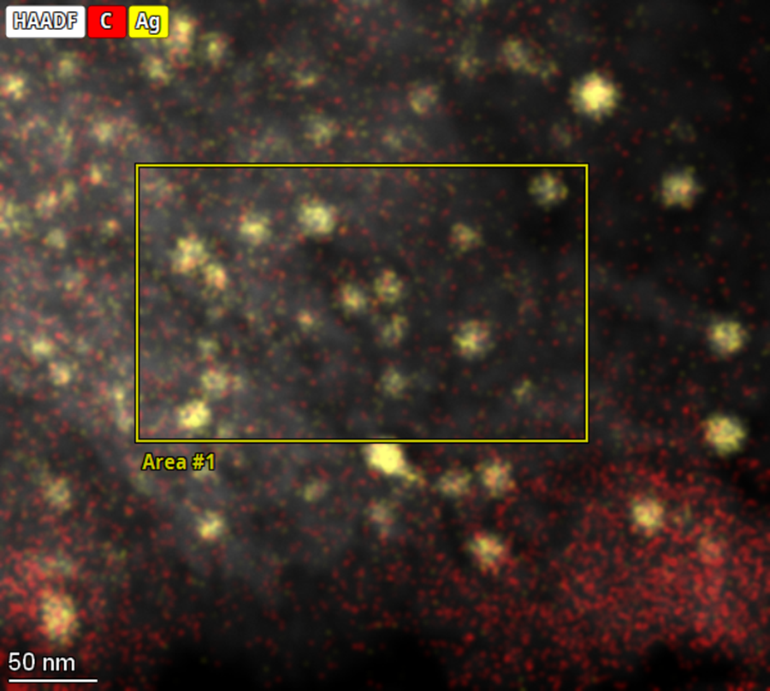
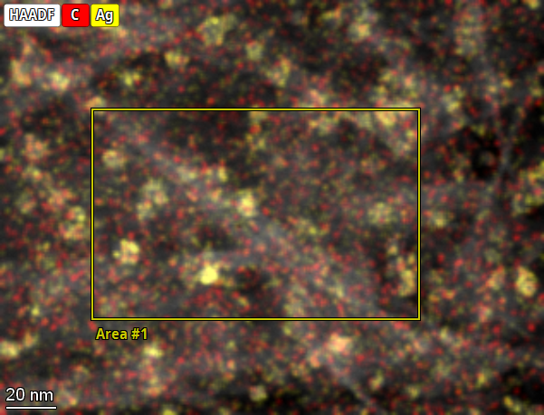
STEM-EDS image for : 2-123417
Spot 1
Element | Atomic Fraction (%) | Mass Fraction (%)
C | 6.34 | 3.80
O | 59.63 | 47.64
Al | 33.35 | 44.93
Ag | 0.67 | 3.62
Spot 2
Element | Atomic Fraction (%) | Mass Fraction (%)
C | 5.41 | 3.25
O | 59.00 | 47.15
Al | 35.18 | 47.41
Ag | 0.41 | 2.20

Slide 6
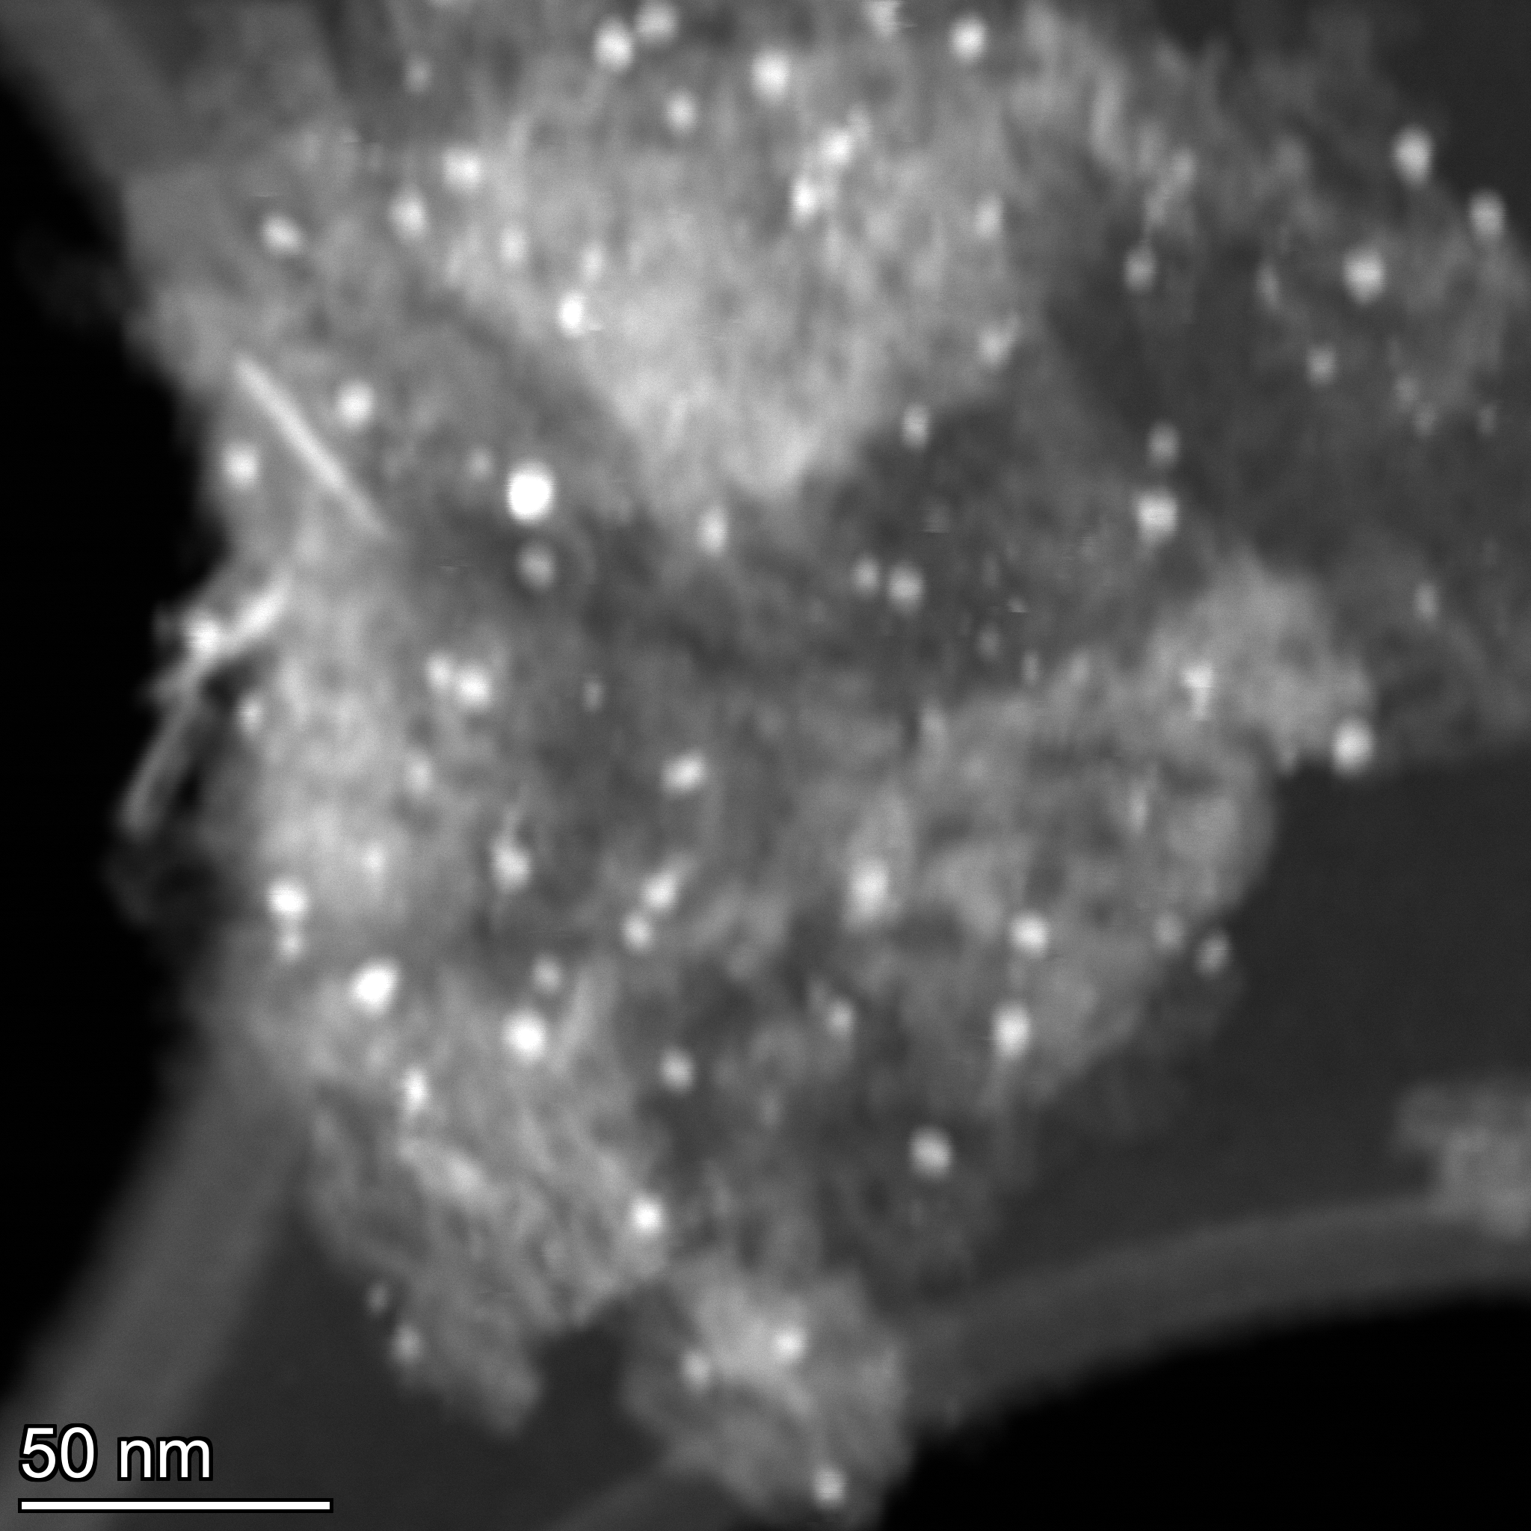
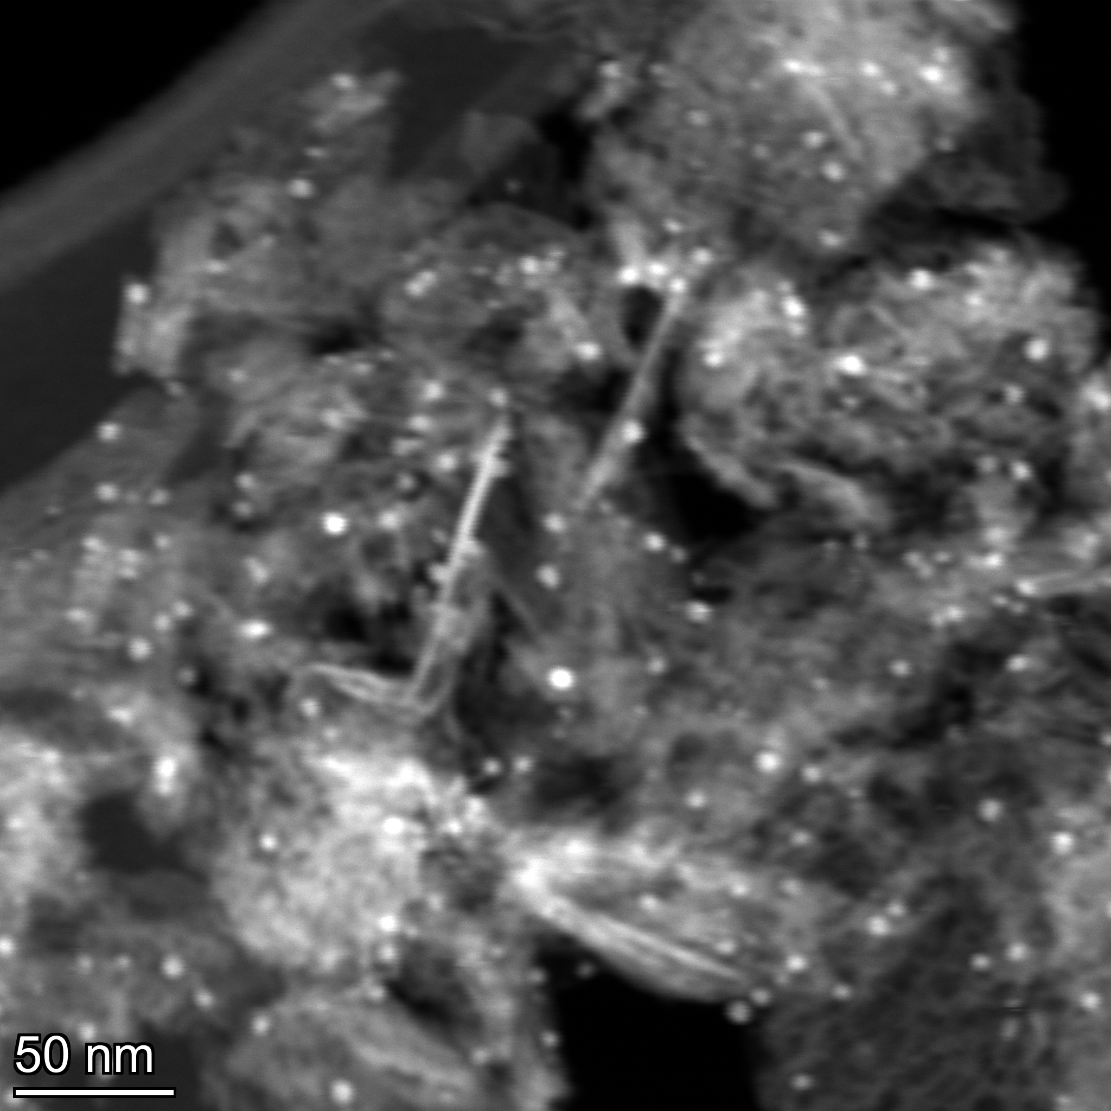
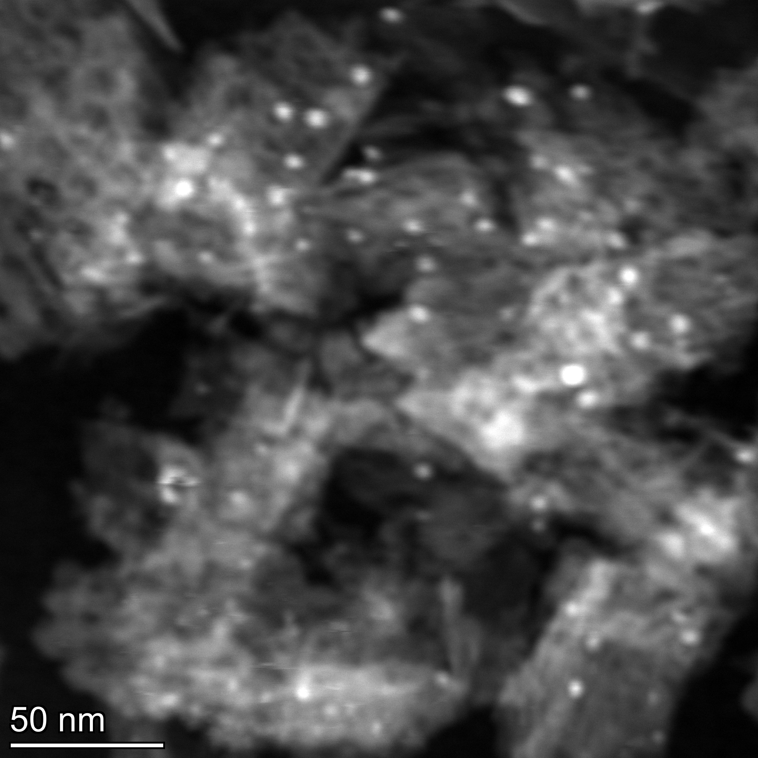
STEM images for : 2-123418
The bright spots are Ag particles (HAADF was used, so heavier elements appear bright) and EDS was used to ensure nothing else was present

Slide 7
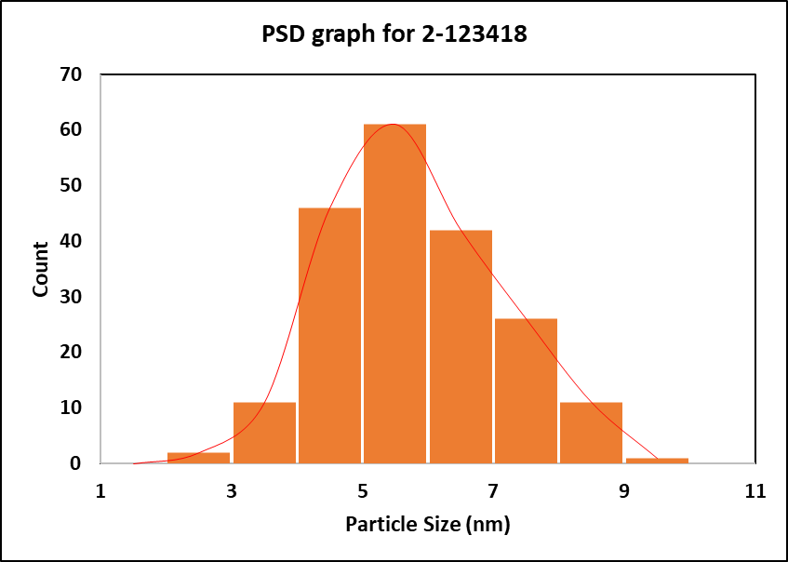
Particle Size Distribution (PSD) Graph for : 2-123418
Average Particle size: 4.8±1.3 nm
A total of 200 particles were analyzed to determine the average particle size of the catalyst

Slide 8
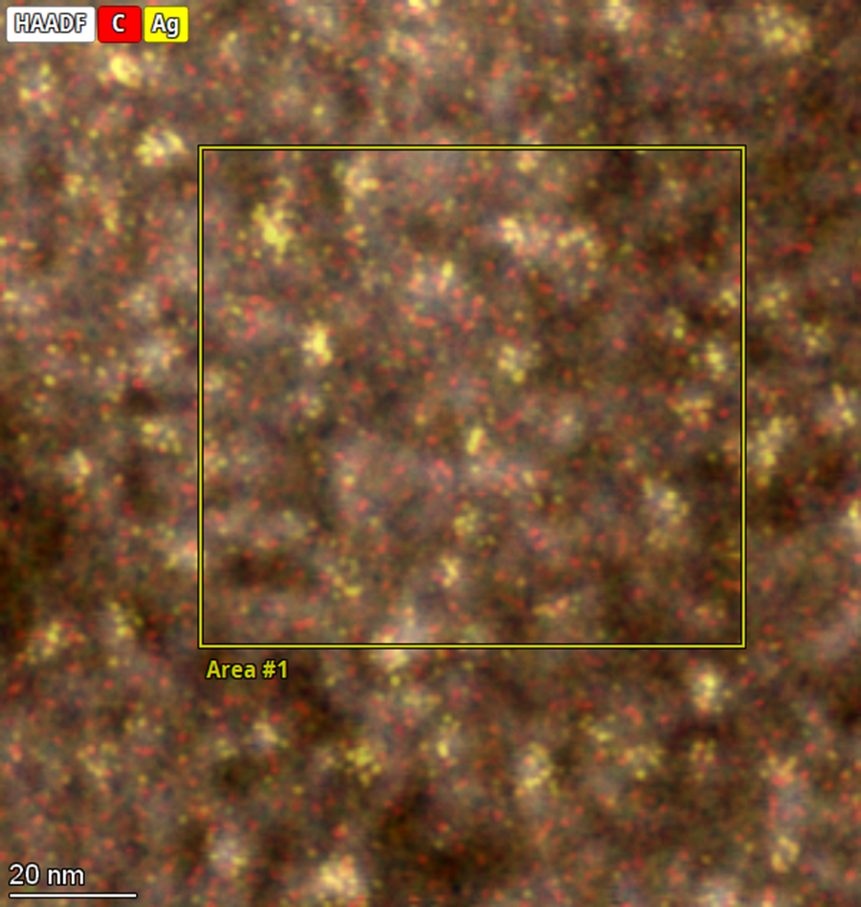
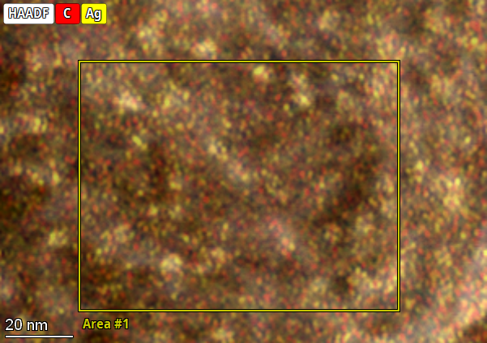
STEM-EDS image for : 2-123418
Spot 1
Element | Atomic Fraction (%) | Mass Fraction (%)
C | 5.41 | 3.25
O | 59.00 | 47.15
Al | 35.18 | 47.41
Ag | 0.41 | 2.20
Spot 2
Element | Atomic Fraction (%) | Mass Fraction (%)
C | 3.93 | 2.33
O | 60.00 | 47.46
Al | 35.55 | 47.42
Ag | 0.52 | 2.78

